Slide 1
AMBIKESHWORI CAMPUS Ghorahi, Dang Bachelor Of Science in Computer Science and Information Technology
C++ Programming Project
Topic:- Scientific Calculator
Submitted by: Submitted to:
Name: Milan Bhandari Er.Sanni Khanal
Roll no: 17
Semester: 2ND

Slide 2
Table Of Contents
Introduction
Aim
Advantages
Disadvantages
Reference
Output

Slide 3
INTRODUCTION
As we all know calculator makes our work easy by solving complex calculations in just a sec.
This programmed calculator can do operations like addition, subtraction, multiplication, division, square, factorial.

Slide 4
AIM
The main aim of the calculator is to give the reliable result in less time .
Complex calculation can be done in seconds.

Slide 5
ADVANTAGES
Calculator gives the exact result without any mistakes.
Times consumed while calculating is drastically reduced.
No need of pen and paper for calculations.

Slide 6
DISADVANTAGES
People become reliable on calculator even for simple calculations.
Only one calculations can be done at a time.

Slide 7
REFERENCE
www.javatpoint.com

Slide 8
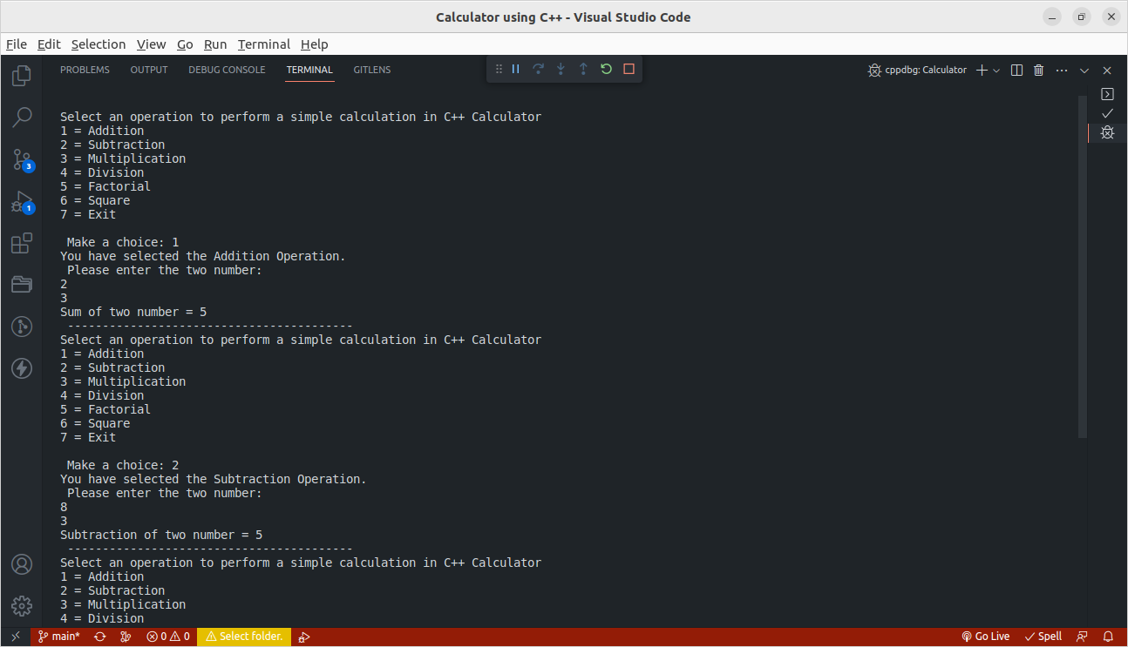
OUTPUT

Slide 9
Thank You !!!

